Slide 1

Payments analysis

Slide 2
DATASET
Timeframe: 2017 jan – 2018 aug
Dataset:
Order list
Customer data
Seller data
Payment
Products
Reviews

Slide 3
OBJECTIVE - MAIN AREAS
Main KPIs
Overall trajectory of the revenue and average order value
Delivery overview
Product overview

Slide 4
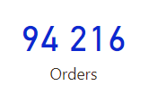
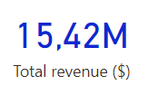

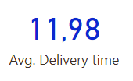
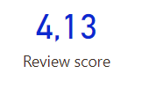
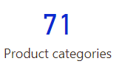
Main kpis

Slide 5
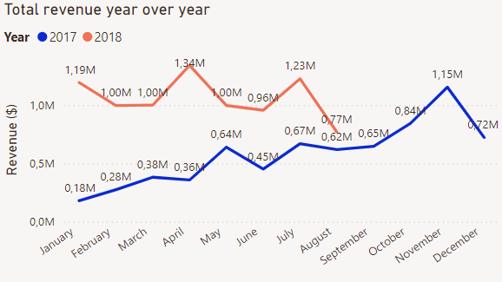
Revenue over time
Overall revenue growth
2018: slow recession

Slide 6
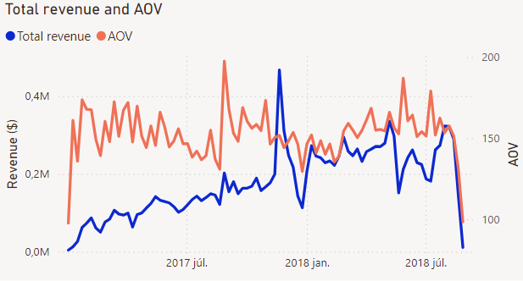
Revenue over time
Black Friday had a big impact on revenue
AOV is rather stagnant
Campaign can be effective
Marketing strategy to increase OV

Slide 7
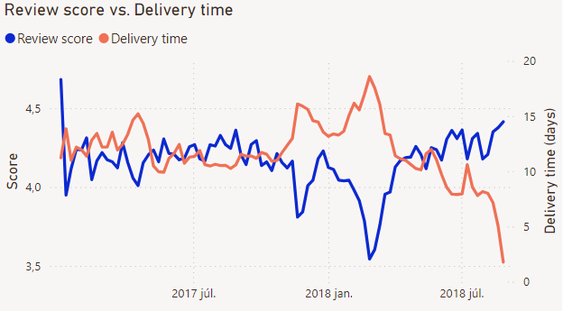
Delivery time and reviews
Clear correlation between delivery time and scores
Prepare for busier periods to maintain good scores

Slide 8
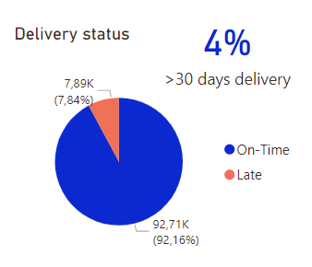
Delivery performance
~ 8% of deliveries are late
4% of deliveries takes longer than a month
Investigate the reasons (might need more capacity)

Slide 9

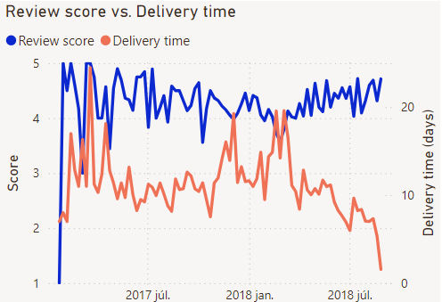
Returning customers
Only 3% returning customer
On average they leave a better review score
Focus more on retention (special deals)

Slide 10
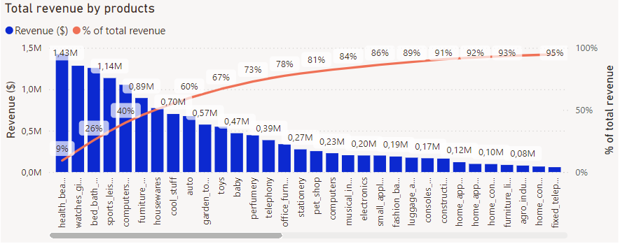
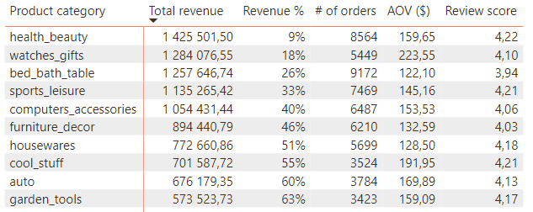
Products
Biggest categories are Health-beauty, Watches-gifts
Pareto chart: 80% of the revenue comes from ~24% of the product categories
Special offers, product promotions would be useful

Slide 11
Conclusions & insights
Revenue growth is slowing down: Implement marketing strategies to
Sttract more customers
Retain existing customers
Increase order value
Prepare for holidays, special occasions with targeted campaigns, increased capacity
Further analysis:
Get data on costs for profit calculation

